Slide 1

Retail Sales Performance Dashboard
By Group 6
4/12/2025

Slide 2
Project Overview
Objective:
To enable data-driven decision-making by visualizing key aspects of retail performance, including customer satisfaction, inventory movement, and sales trends.
Project Scope:
The dashboard empowers marketing, sales, and inventory teams to align strategies with high-impact patterns and customer segments.
It is a comprehensive tool for analyzing and managing retail sales data effectively.
It integrates key metrics into one interface.
Complex data is presented through intuitive visual formats for quick understanding.
Users can easily identify trends, discover opportunities, and pinpoint improvement areas.

Slide 3
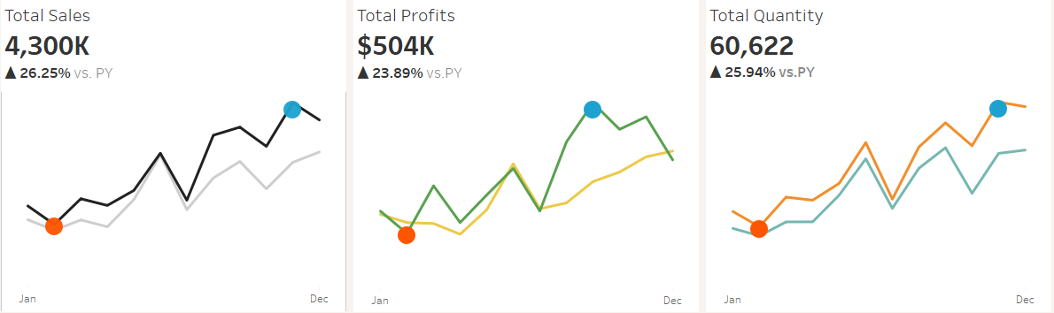
Key Performance Indicators
Total Sales:
Provides a comparison of total monthly sales for the current year (CY) against the previous year (PY).
The orange dot marks the lowest sales month within the current year while the blue dot marks the highest sales month within the current year.
Total Profits:
Compares total monthly profits for the current year (CY) and the previous year (PY).
The orange dot indicates the lowest profit month in the current year while the blue dot indicates the highest profit month in the current year.
Total Quantity:
Tracks the total quantity of items sold monthly, comparing the current year (CY) with the previous year (PY).
The orange dot shows the lowest quantity sold in the current year while the blue dot shows the highest quantity sold in the current year.

Slide 4
Dashboard Components and Business Value
Customer Satisfaction
Customer Analysis:
Shows the number of orders per customer.
Helps in segmentation and targeted marketing.
Top Customers:
Lists top customers by name, last order date, profit, sales, and number of orders.
Identifies high-value accounts for retention and loyalty strategies.
Customer Satisfaction Score:
Shows count of customers by satisfaction score (1 lowest to 5 highest).
Feedback-driven metric to refine customer experience strategies.
Trend Analysis
Sales &Profit over Time:
Tracks weekly sales and profits.
To spot anomalies, evaluate campaign effectiveness, and budget smarter.
Inventory Levels
Quantity Sold:
Shows the total quantity sold over the current year and the year-over-year growth.
Helps track how stock moves.
Sales &Profits by Subcategory:
Compares 2014 vs 2013 sales and profit by subcategory.
Detects best- and worst-performing categories, aligning product strategies with Rate of Interest (ROI).

Slide 5
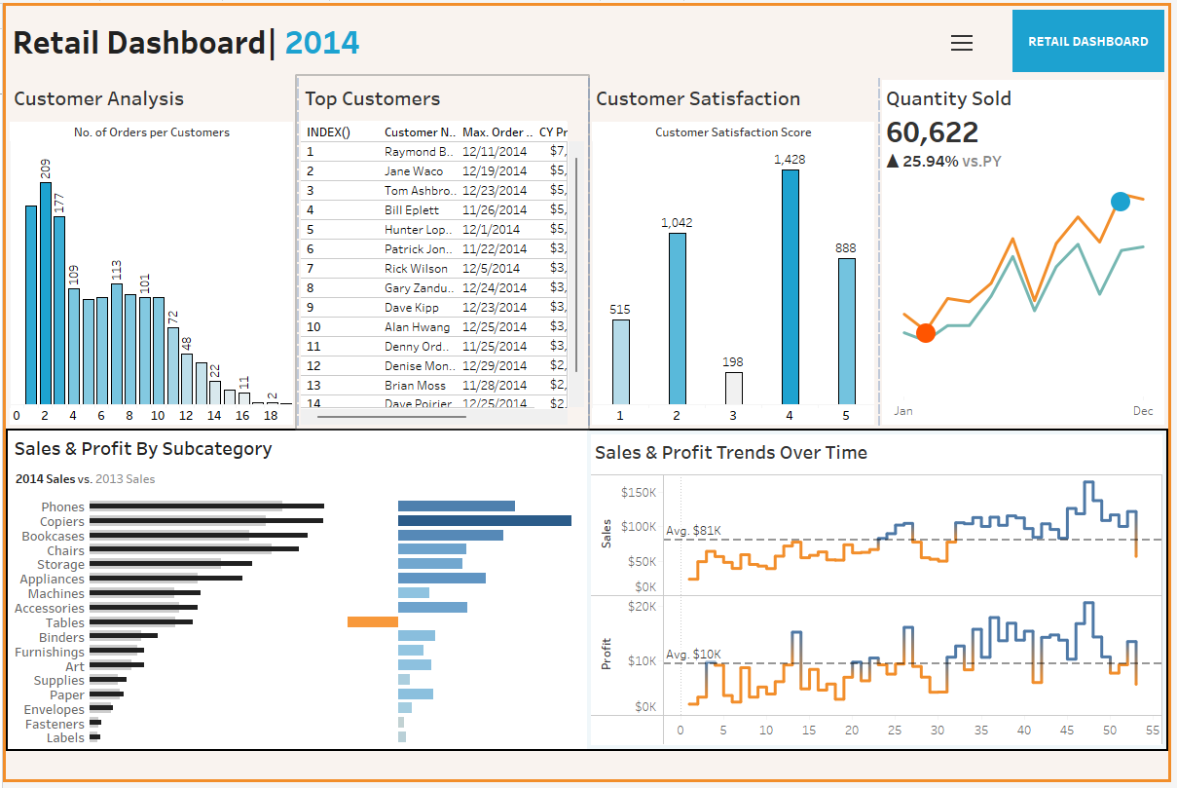
Tableau Dashboard

Slide 6

Outcomes
Customer Satisfaction
The most ratings clustered at Score 4 (1,428), a strong indication of a positive customer experience.
The scores 1 and 2 can help tailor customer satisfaction strategies.
Inventory
60,622 units sold, with a +25.94% year-over-year increase shows robust growth in demand.
Phones and Copiers are top performers in both sales and profit.
Tables generated losses despite decent sales.
Trend Analysis
Weekly sales averaged $81K, showing steady performance
Profits averaged $10K weekly

Slide 7
Conclusion
The retail dashboard highlights good business performance;
Strong customer acquisition, retention, and growth.
High satisfaction among engaged customers.
High sales and profits within specific subcategories.
Averagely good sales and profits distribution within the year.

Slide 8
Thank you

